Slide 1
Computational Intelligence and Decision Making
Lab Work - 1
Ravinthiran Partheepan
Master’s in Artificial Intelligence
Semester: 1 / Year: 1
Kaunas University of Technology

Slide 2
About the Task
Problem: based on the given data of historical real estate transactions create the decision-making model (DMM) which aims to predict prices of new real estate objects.
Project workflow:
P1. Perform given data analysis and preprocessing
P2. Implement K-Nearest Neighbors (KNN), Decision tree (DT), and random forest (RF) algorithms (You cannot use library functions for these algorithms)
P3. Use implemented algorithms to create DMM for the given problem and evaluate the results.
P4. Use “scikit-learn” (or other) library functions for the same algorithms and evaluate the results.
P5. Write conclusions.

Slide 3
Libraries Used
Pandas
Numpy
Sklearn

Slide 4
About Dataset
Features | Type
Id (Dropped) | Numerical
LotArea | Numerical
YearBuilt | Numerical
YearRemodAdd | Numerical
SalePrice | Numerical
Features | Data Type
Id | Int64
LotFrontage | Float64
LotArea | Int64
Street | Object
Neighorhood | Object
YearBuilt | Int64
YearRemodAdd | Int64
CentralAir | Object
PavedDrive | Object
SaleCondition | Object
SalePrice | Int64
Numerical
Categorical
Features | Type
Street | String
Centrail Air | Boolean
Paved Drive | Boolean
SaleCondition | String

Slide 5

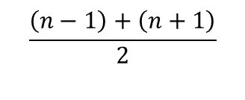
Data Quality Test – Missing Value Imputation
Features | Missing Values
Id | 0
LotFrontage | 173
LotArea | 0
Street | 0
Neighorhood | 0
YearBuilt | 0
YearRemodAdd | 0
CentralAir | 0
PavedDrive | 0
SaleCondition | 0
SalePrice | 0
Features | Missing Values
Id | 0
LotFrontage | 0
LotArea | 0
Street | 0
Neighorhood | 0
YearBuilt | 0
YearRemodAdd | 0
CentralAir | 0
PavedDrive | 0
SaleCondition | 0
SalePrice | 0
Median Imputation
$$\frac{\left(n−1\right)+\left(n+1\right)}{2}$$
Alternative: - Mean
$$μ=\frac{\sum{{elements}_{i}}}{n}$$

Slide 6
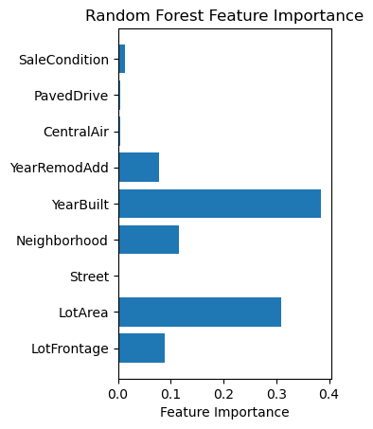
Feature Selection
Feature importance was evaluated using the random forest approach or we can also any tree-based approach for feature selection such as Decision tree, etc.,
Based on the visualization, we can interpret the features [YearBuilt, Neighborhood, LotArea, LotFrontage] carries a lot of weight which influence the SalePrice of a hosuing.

Slide 7
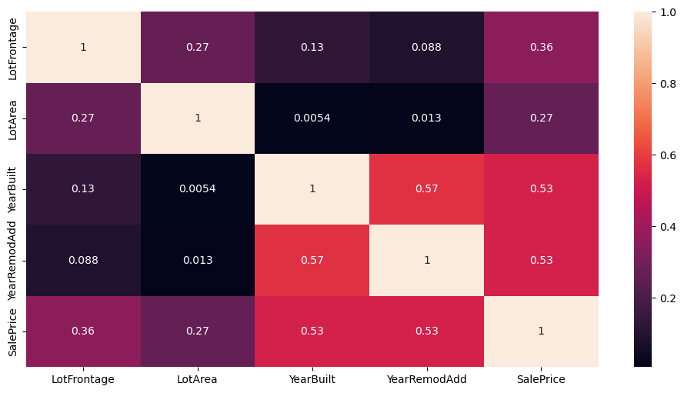
Correlation Analysis
Interpretation:
Based on the visualization, we can interpret the features in the diagonal position are strongly correlated with each other and it is represented with the value 1.
The features which are positively correlated with each other was indicated in darker color
Since, there are no features which are represented in negative magnitude so we can say most of the features are correlated with each other.

Slide 8
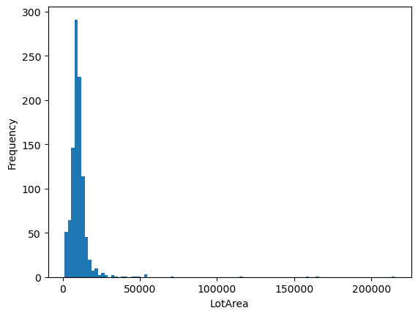
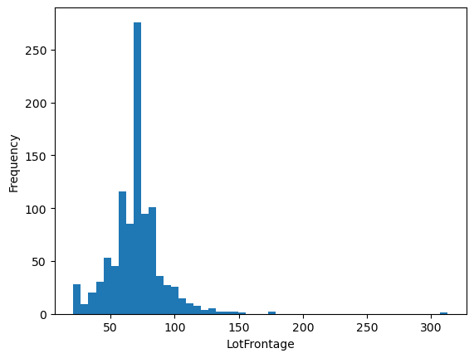
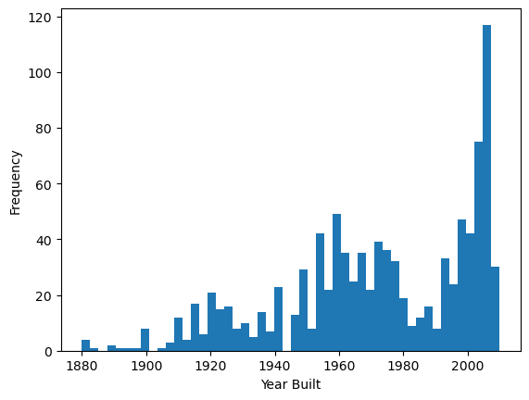
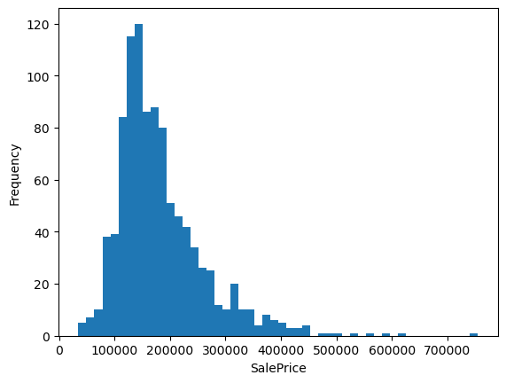
Data Distribution
Interpretation:
Since most of important features follows the Gaussian Distribution.
In SalePrice feature, there is a presence of kurtosis at the end of the distribution tail.
[2] Fatness at the end of the tail is usually called Leptokurtic which indicates there is a presence of outliers in smaller scale.

Slide 9
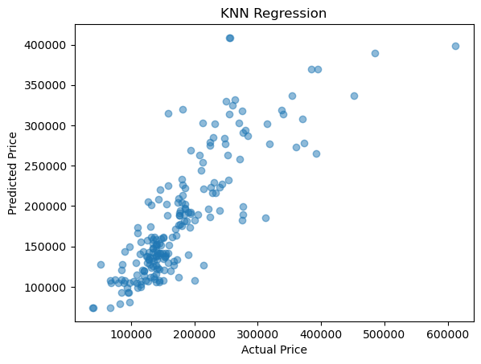
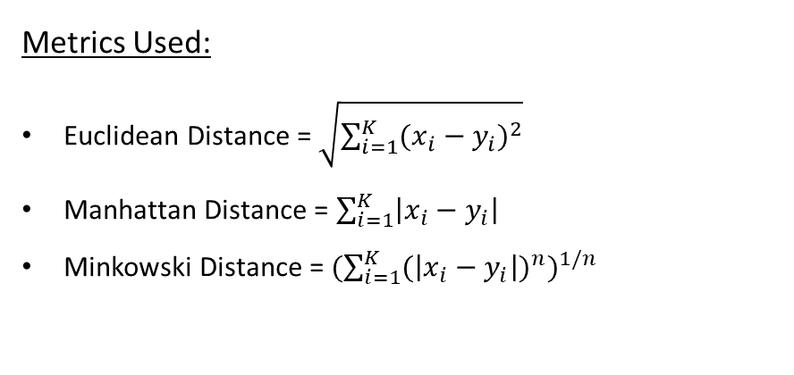
K-Nearest Neighbors
Metrics Used:
Euclidean Distance = $\sqrt{\sum_{i=1}^{K}{{(x_{i}−y_{i})}^{2}}}$
Manhattan Distance = $\sum_{i=1}^{K}{\left|x_{i}−y_{i}\right|}$
Minkowski Distance = ${(\sum_{i=1}^{K}{{(\left|x_{i}−y_{i}\right|)}^{n}})}^{1/n}$
Result Interpretation:
Based on the visualization, we can interpret the KNN regressor model has predicted that actual value is somewhat closer to the predicted value.
For short distance, 4 nearest neighbors was considered which can be represented as K=4

Slide 10
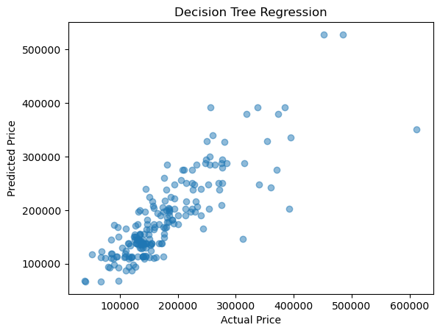
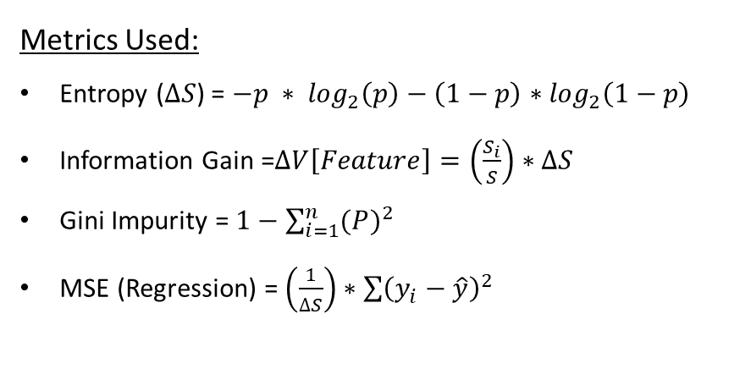
Decision Tree Regressor
Metrics Used:
Entropy ($∆S$) = $−p ∗ \log_{2}\left(p\right)−\left(1−p\right)∗$ $\log_{2}\left(1−p\right)$
Information Gain =$∆V\left[Feature\right]=\left(\frac{S_{i}}{S}\right)∗∆S$
Gini Impurity = $1−\sum_{i=1}^{n}{{(P)}^{2}}$
MSE (Regression) = $\left(\frac{1}{∆S}\right)∗\sum{{\left(y_{i}−\hat{y}\right)}^{2}}$
Result Interpretation:
Based on the visualization, we can interpret the Decision Tree regressor model has predicted that actual value is not really closer to the predicted value.
Decision Tree Hyperparameter optimal choice: DecisionTreeRegressor(max_depth=10, min_samples_leaf=4, random_state=42)

Slide 11
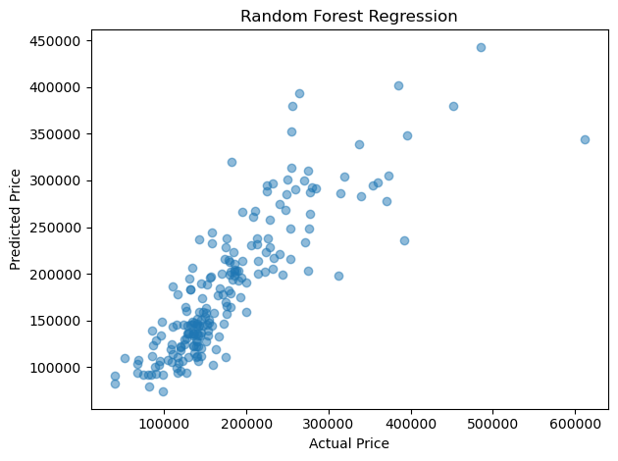
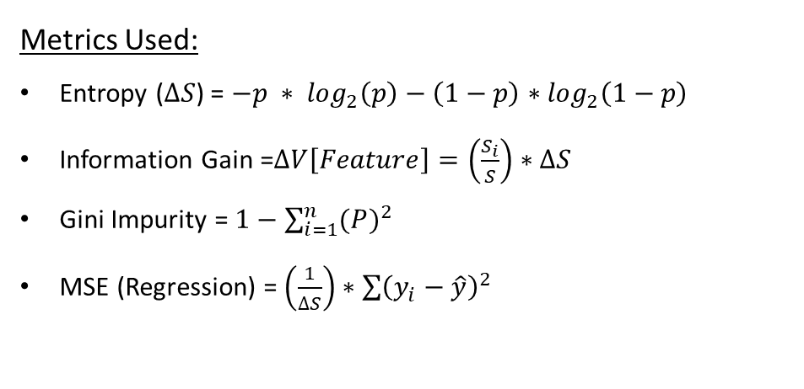
Random Forest Regressor
Metrics Used:
Entropy ($∆S$) = $−p ∗ \log_{2}\left(p\right)−\left(1−p\right)∗$ $\log_{2}\left(1−p\right)$
Information Gain =$∆V\left[Feature\right]=\left(\frac{S_{i}}{S}\right)∗∆S$
Gini Impurity = $1−\sum_{i=1}^{n}{{(P)}^{2}}$
MSE (Regression) = $\left(\frac{1}{∆S}\right)∗\sum{{\left(y_{i}−\hat{y}\right)}^{2}}$
Result Interpretation:
Based on the visualization, we can interpret the Random Forest model has predicted that actual value is closer to the predicted value.
Random Forest Hyperparameter optimal choice: RandomForestRegressor(n_estimators=150, random_state=42)

Slide 12
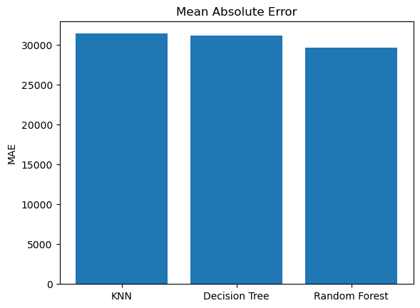
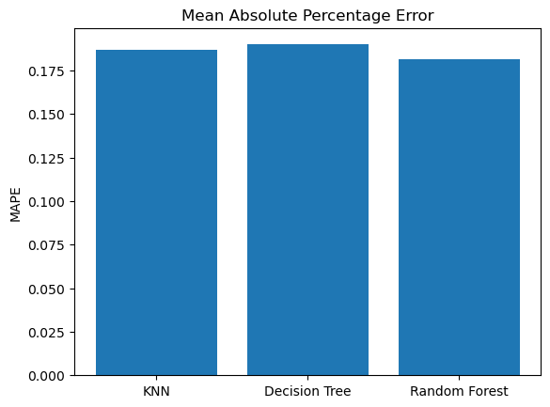
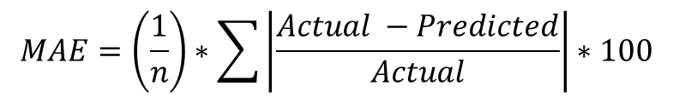
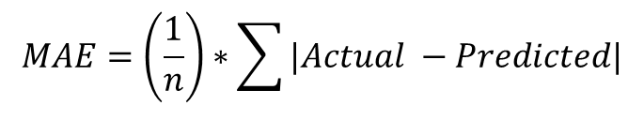
Evaluation Metrics
$$MAE=\left(\frac{1}{n}\right)∗\sum{|Actual −Predicted|}$$
$$MAE=\left(\frac{1}{n}\right)∗\sum{\left|\frac{Actual −Predicted}{Actual}\right|∗100}$$

Slide 13
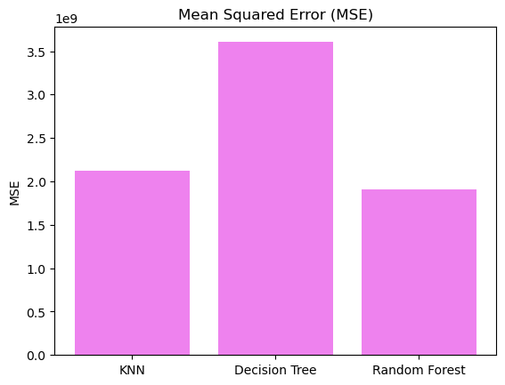
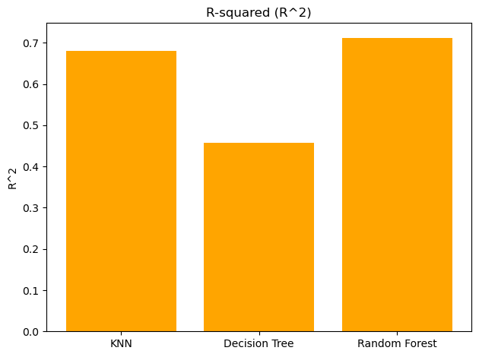
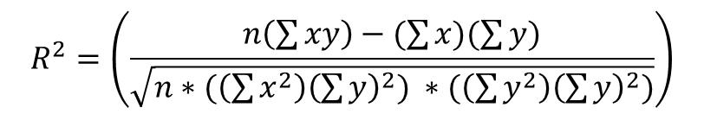
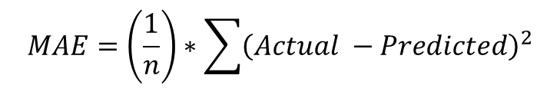
Evaluation Metrics
$$MAE=\left(\frac{1}{n}\right)∗\sum{{\left(Actual −Predicted\right)}^{2}}$$
$$R^{2}=\left(\frac{n\left(\sum{xy}\right)−(\sum{x})(\sum{y})}{\sqrt{n∗(\left(\sum{x^{2}}\right){\left(\sum{y}\right)}^{2}) ∗(\left(\sum{y^{2}}\right){\left(\sum{y}\right)}^{2})}}\right)$$

Slide 14
Conclusion
Based on the results, Random Forest model has the lower Mean Squared Error rate (Squared difference between the actual value and the predicted value) with the value of 1.8 compared to Decision Tree and KNN Models.
From R-Squared evaluation metric perspective, Random Forest produced 0.7 units compared to KNN = 0.67, and Decision Tree = 0.41 which indicates [1] Random Forest model analyzed there is a high correlation between features which explains there is small difference between the actual value and fitted value or predicted value.
Repository: https://github.com/ravinthiranpartheepan1407/ML-Tasks/tree/main/CI-DM
Additional Slides:
KNN: https://assets.super.so/7d26cd67-f43c-4085-8f4c-2a4594e5dd30/files/1bc699b1-2f3b-4566-a5f0-830c694fbfc6.pdf
Decision Tree: https://assets.super.so/7d26cd67-f43c-4085-8f4c-2a4594e5dd30/files/9b9f66b2-cc7f-42df-9492-35dd30df29b0.pdf
Website: https://ravinthiranpartheepanwiki.super.site/
Future Work Consideration: Comparive study between sklearn vs Vertez (Link: https://pypi.org/project/vertezml/ )

Slide 15
Reference
[1] https://statisticsbyjim.com/regression/interpret-r-squared-regression/
[2] https://www.scribbr.com/statistics/kurtosis/

Slide 16
Thank you!
Would you like to ask me any questions related to this task?

